Slide 1

VirtualEd
REKINDLING EDUCATION THROUGH VIRTUAL REALITY

Slide 2
THE PROBLEM
Good laboratory labs in Public and Private Schools is a problem in Africa, often attributed to poor infrastructures, teaching aids such as (Computers and Laboratories),
Paucity of quality teachers and poor/polluted learning environment. With the number of students who finished school without any knowledge of how the human anatomy is had been calculated to be 6.9m (Nigeria ) and 127 million in Africa
01

Slide 3
VALUE PROPOSITION
VirtualEd utilizes 3d forms and images of the human anatomy to support textbook learning. Students are able to visualize internal organs of the body in detail. Curriculum can be updated with opportunity for feedback, quiz exercises, and activities to make learning practical and a fun experience for students in primary and secondary schools in Africa.
At the tertiary level, Virtual-Ed can be used for human anatomy simulations in laboratories and real-time feedback for lecturers to track learning progress.
02

Slide 4
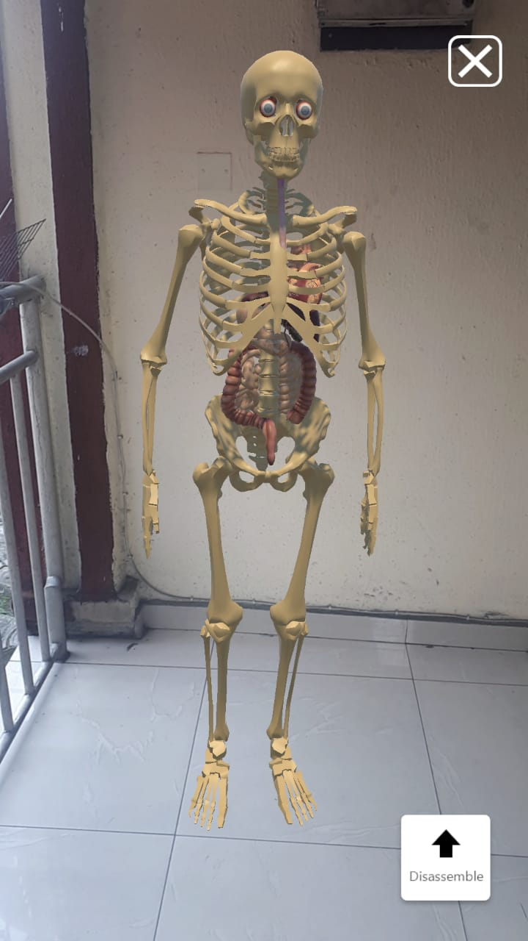
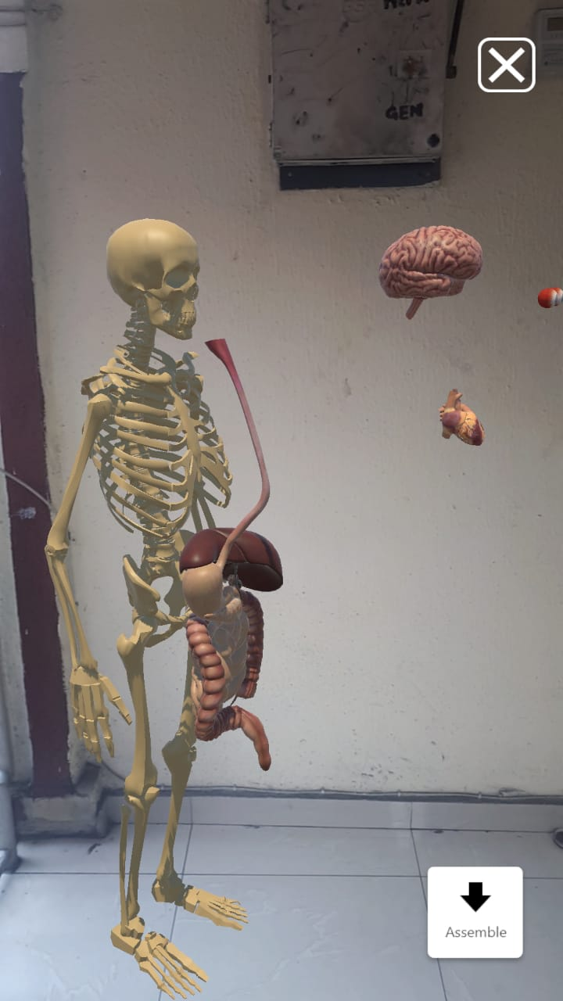
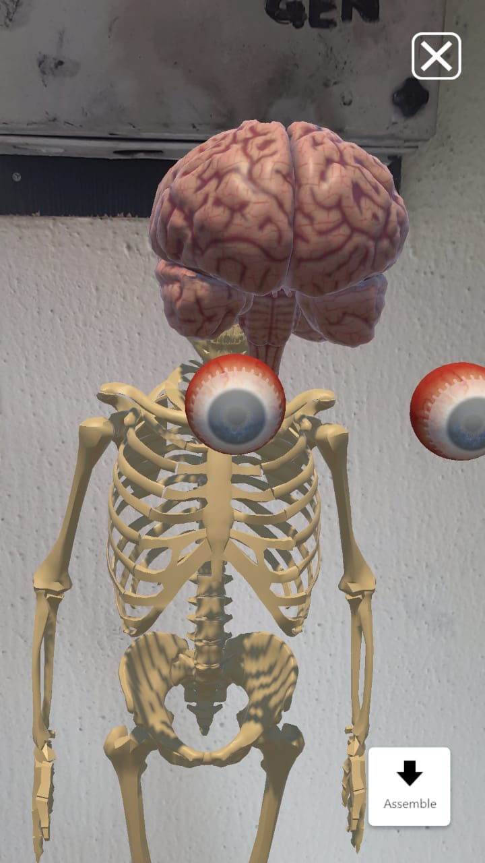
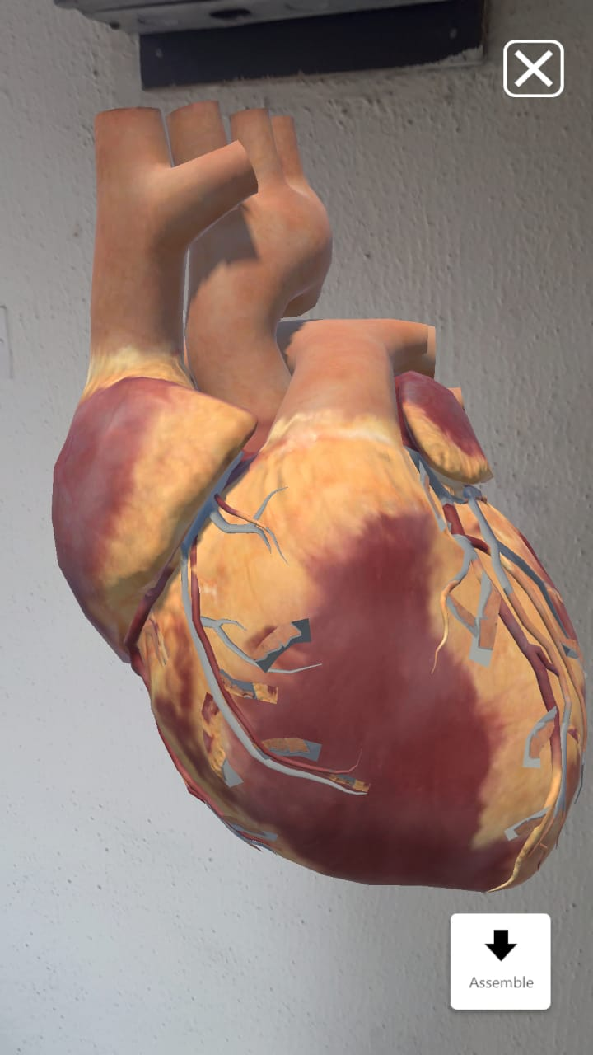
Virtual Ed PRODUCT
Images using VirtualEd
03

Slide 5



VirtualEd PRODUCT
Virtual-Ed is built with Vuforia Engine, unity3D and C-sharp.
Virtual-Ed offers unique teaching and learning experience of visualizing and interacting with 3d images of human anatomy/specimen. Users can interact using a smartphone, tablet and other VR enable device.
This is a no solution of this yet in Nigeria and Africa using augmented reality.
03

Slide 6
BUSINESS MODEL
VirtualEd is an Educational Tech solution for secondary school students, so there lies our money!
VirtualEd Package consists of :
A Tablet and a 3D textbook which goes for $200 (N88,788.00)
Yearly updates $24 (N10,654.56)
I.E, 1000 (students) X $200 (N88,788) = 88,788,000
In 5 years, we hope to have more than 5,000 students using VirtualEd pack in Nigeria across primary, secondary and tertiary levels.
04

Slide 7
MARKETING PLAN
School/university
Demos
Social media
Ads
Yearly
Subscription
TV Ads
05

Slide 8
COMPETITION
Major Players in the Education Tech sector
- Ulesson
It leverages best in class teachers, media, and technology to create high-quality, affordable and accessible education for African students.
- Brainfriend
Is an e-learning software with over 60 subjects and quality study materials to help you learn effectively and improve your grades.
06

Slide 9
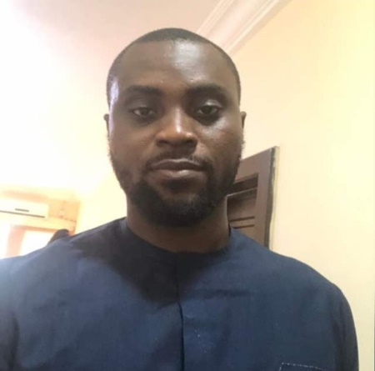

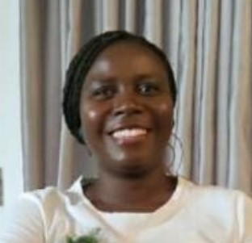

TEAM MEMBERS
IFEANYI ODIWE
AKOREDE DASILVA
XR Developer
XR Developer
PEACE LAWSON
GOSPEL ONOWI
UI/UX
Mentor
07

Slide 10
BUDGET BREAKDOWN PROPOSAL
Cost Of Development
- 3D Modelers (2)
- 2D animators (2)
- C# Developer (2)
- UI Designer (1)
- Content creators (3)
- Accountant (1)
$30,000
(6 months running cost)
Infrastructure Cost
- Systems
- Tablets
- VR Headgears
- Storage Drives
- Power
- Internet
Etc.
$25,000
Maketing Expense
- TV Ads. Social media, radio, journals, etc
$20,000
(24 months running cost)
Software License
$3000
Miscellaneous
$22000
ASKING PRICE: $100,000
08

Slide 11
Thank you
Questions?
03

